Slide 1

MEDIA
MIX
MODELLING

Slide 2
In today’s menu…
Goal
About the data
Methodology
Results
For Whom
Future Scope

Slide 3
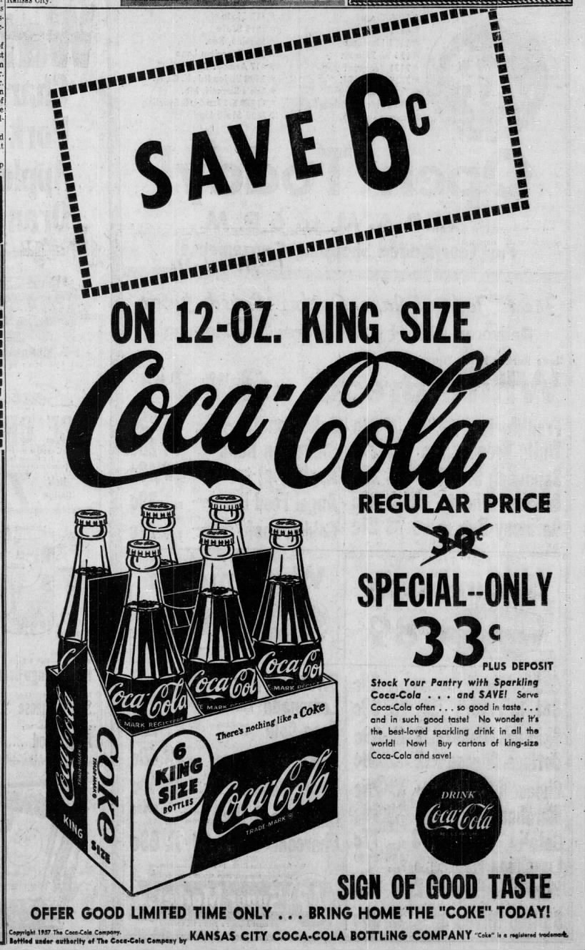
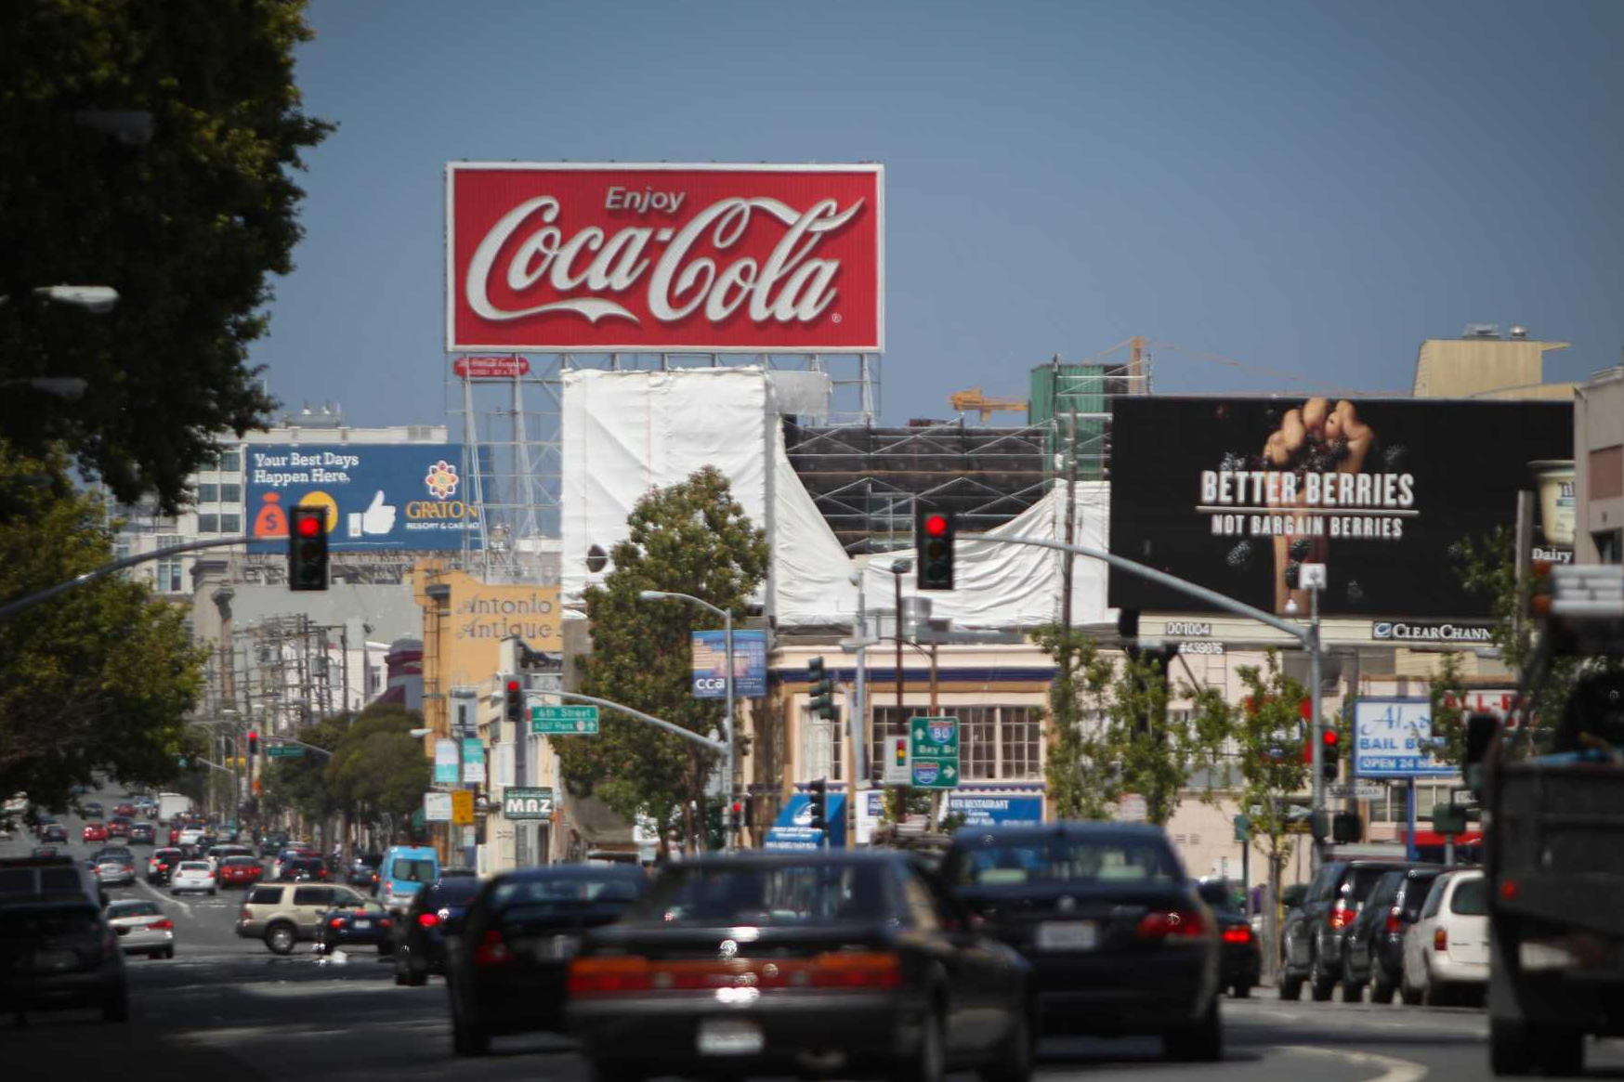
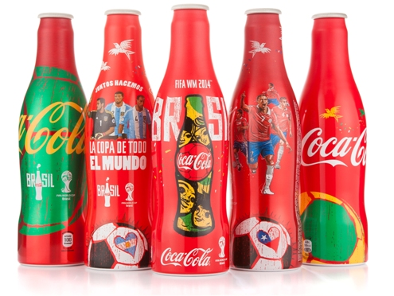
Basic Concept: A way to ensure that the money spent on advertising is worth the returns
- Evaluating ROI on Sales, given budget used for different channels for ads and/or other promotion tools
- Common ones we see frequently right now: Instagram recommendations, email subscriptions, web add-ins, mail deliveries, magazine, billboards, event sponsorships, etc.
San Francisco Billboard
2014 World Cup Campaign
1957 Newspaper

Slide 4
We found a data with different channel spend and revenue generated
variables
description
Division | Company Division (A-Z)
Calendar_Week | Week of the year
Paid_Views | YouTube Paid Views
Organic_Views | YouTube Organic Views
Google_Impressions | Google
Email_Impressions | Direct Emails
Facebook_Impressions | Facebook
Affiliate_Impressions | Affiliate Marketing
Overall_Views | Summation of all views
Sales | Total Sales generated per week
Source: Kaggle
3050 data points
10 features
Notes:
Scaling/transformations applied to the fields:
Explain ad_stock
Logged value for regression significance and multicollinearity

Slide 5
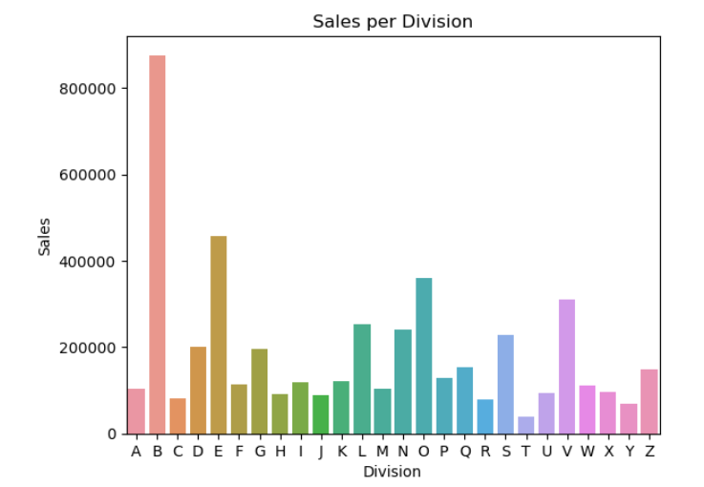
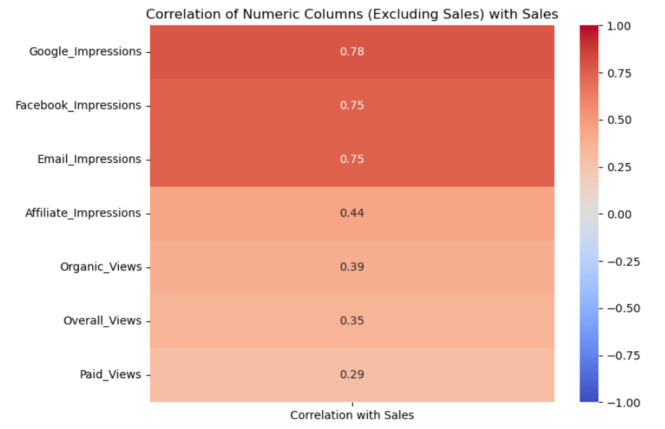
We started with data exploration and visualization

Slide 6
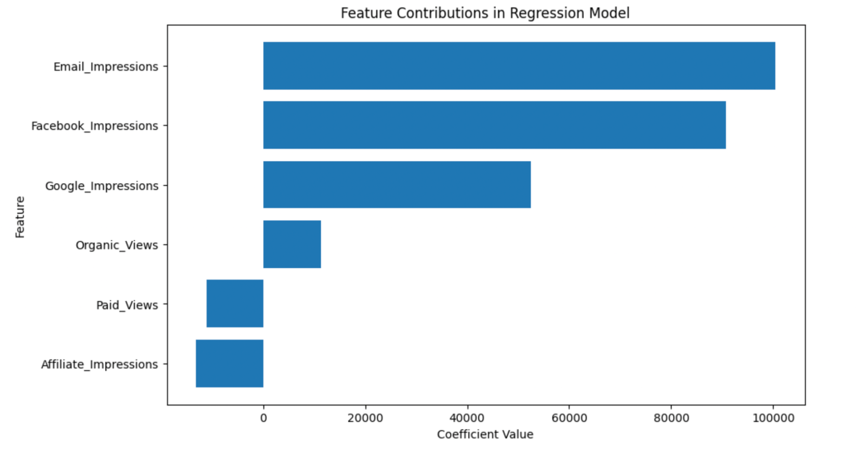
We applied 2 versions of linear regression and Hill-Adstock model
Importance of different marketing channels in a regression model.
Length of each bar representing the strength of each channel's impact.
Email Impressions have the most significant influence, followed by Facebook, Google.
Notes:
we divide the data on media and the target by their mean to ensure that the result has a mean of 1. This allows the model to be agnostic to the scale of the inputs (e.g. a user can use either the number of sales or the value of sales). The costs are not used in the model directly, they are only used to inform the prior distributions on the media variables . These costs have been scaled down by multiplying by 0.15 to reflect typical ranges in MMMs.

Slide 7
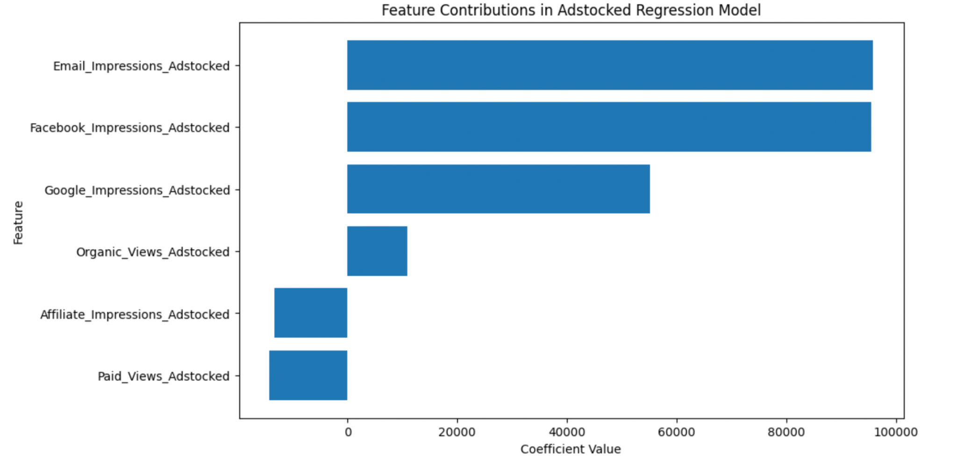
We applied 2 versions of linear regression and Hill-Adstock model
Contributions of various adstocked marketing channels in a regression model, indicating their weighted impact on a dependent variable.
'Adstocked' implies that the effects of these channels are considered over time, not just immediately.
Email and Facebook adstocked impressions are the most impactful, followed by Google.

Slide 8
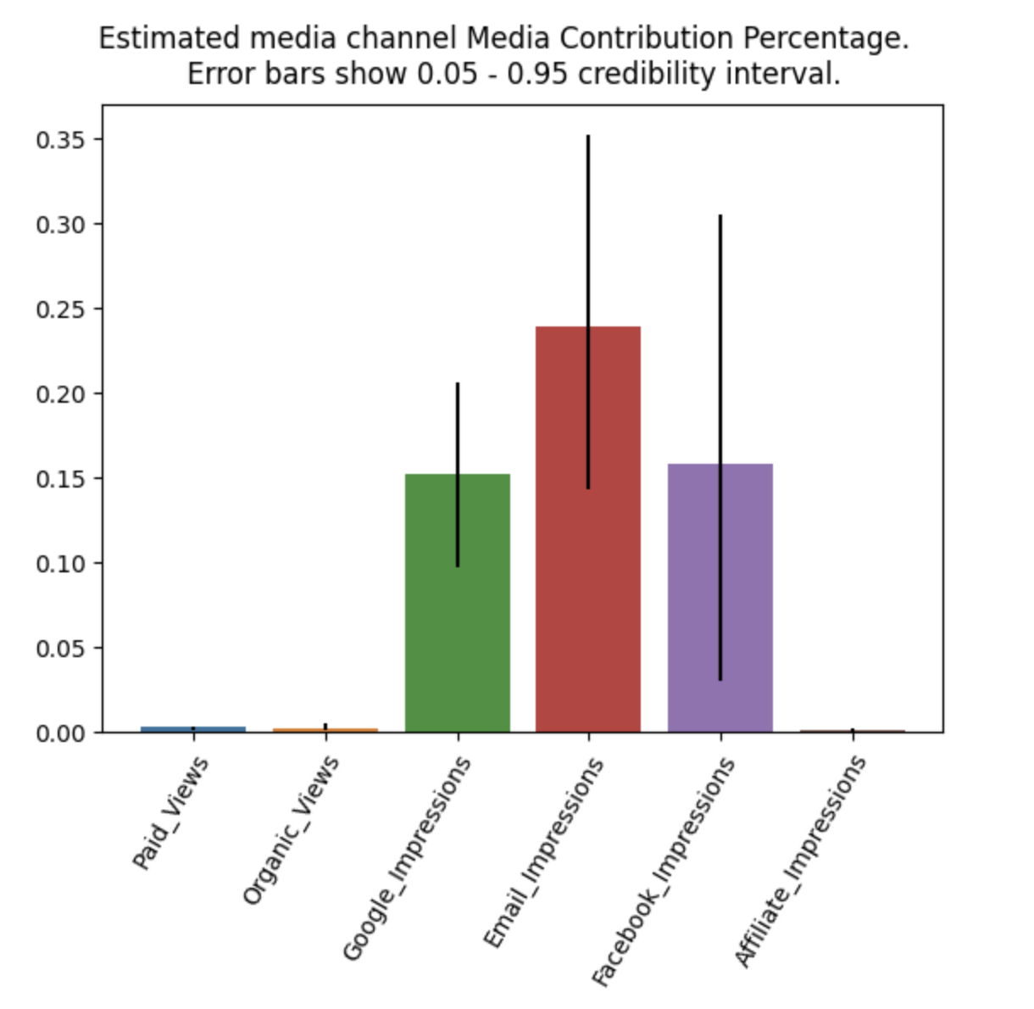
We applied 2 versions of linear regression and Hill-Adstock model
This model is based on library “Light mmm” by Google allows to implement bayesian based model.
Email impressions having the highest estimated contribution, followed closely by Facebook and Google.

Slide 9
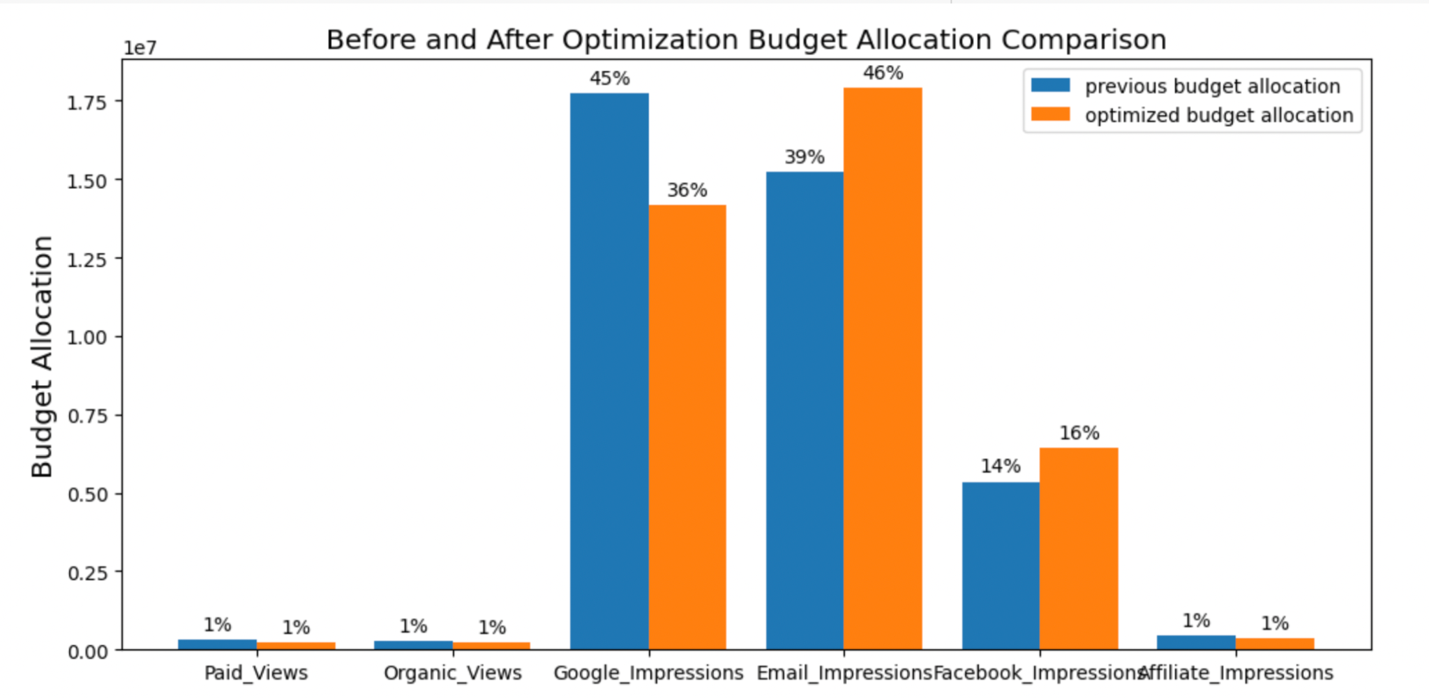
We propose a redefined budget allocation for the company for increased Sales

Slide 10
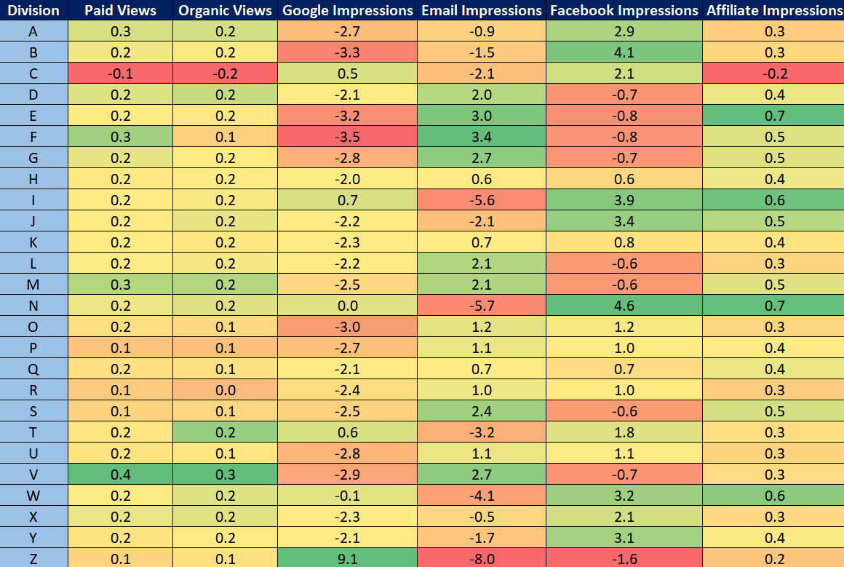
We propose a redefined budget allocation for each division also
Allocation in % change for each division
Notes:
Recommend the strong green color to be the destination for budget in

Slide 11
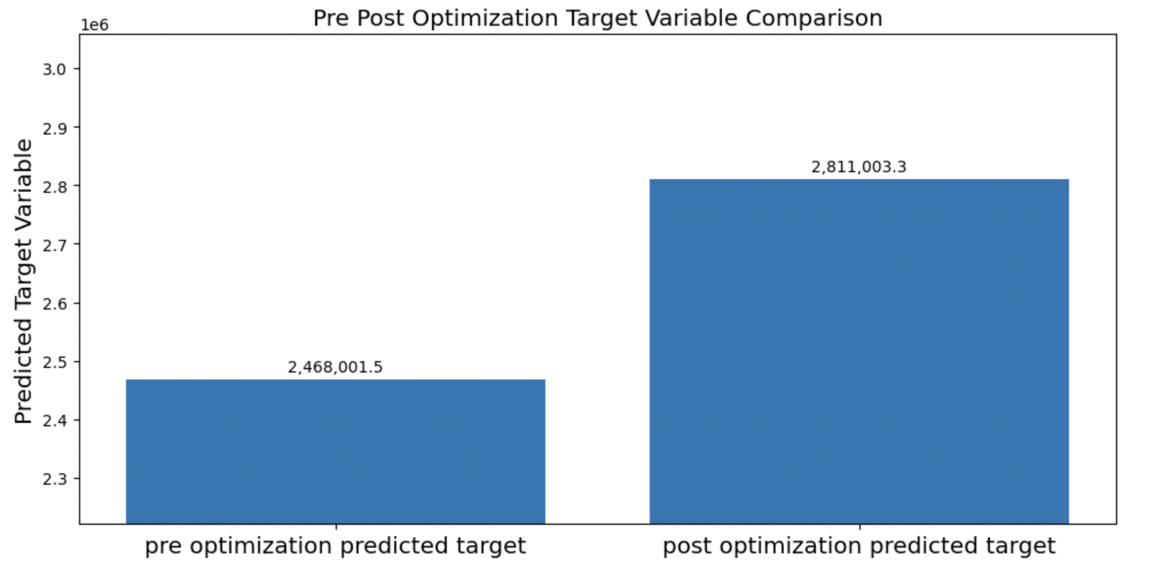
This model will help the company to reallocate the resources and increase the revenue
+13.9%

Slide 12
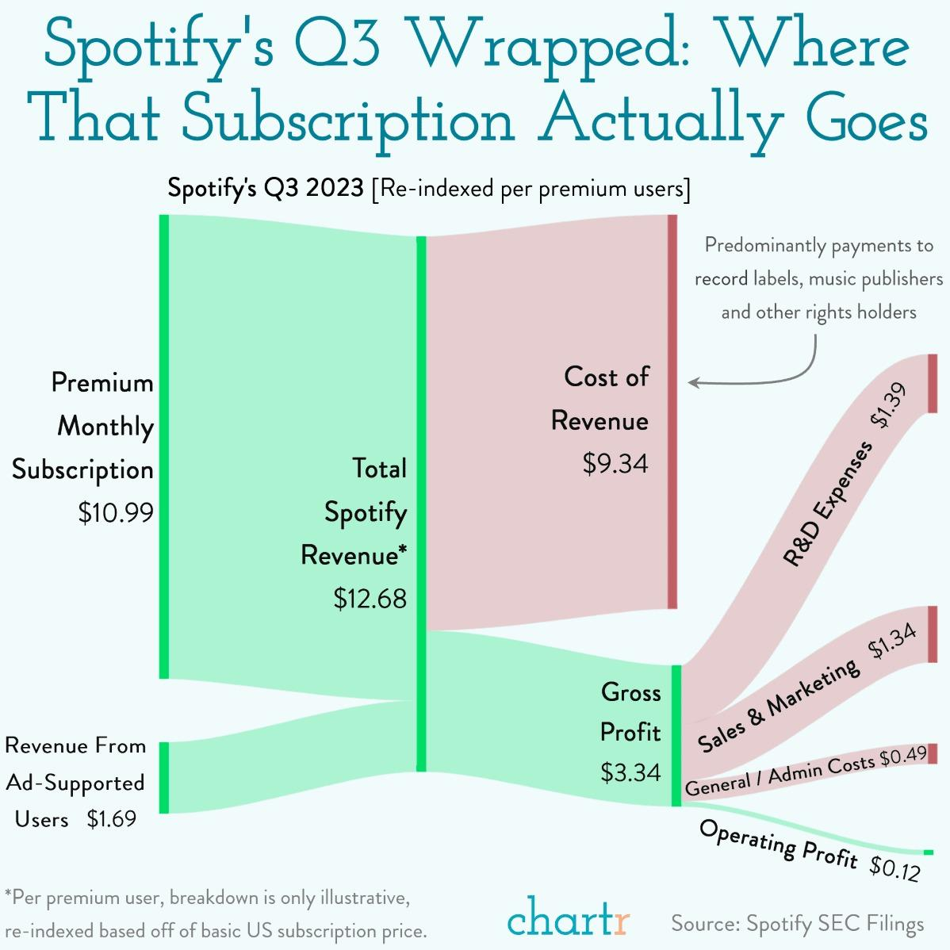
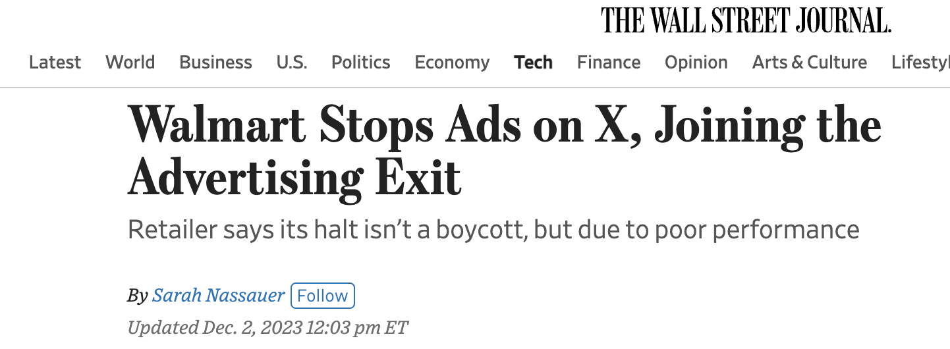
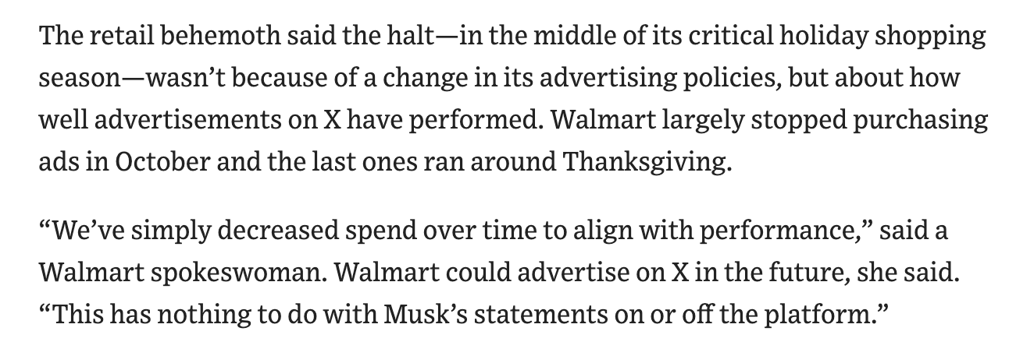
This model will be a huge boon for any product based company
Notes:
After seeing the models, terminologies and calculations on our selected dataset, let’s have a look at the actual companies and how their marketing spendings are being evaluated.
As we can see from the newest quarterly figures for spotify, among the 12.68 dollars/mo per user revenue they get, they would get 3.3 usd gross profit, and more than ⅓ of this chunk is spent on sales and marketing category, whilst only ending with 12 cents of operating profit (around 1%);
Another piece of industry news that echos with our topic today is Walmart deciding to stop spending on ads on twitter, as they found out the expected performance on return of marketing cost is not satisfactory.

Slide 13
In future we would like to expand our work
Data with externalities (seasonality , trends, holidays)
Distributing budget allocation between different divisions if available
Data Volume
Real-time company data
Notes:
In reflection of the work we’ve looked through and done in the past few weeks, we would like to see the next steps to improve on, including: more explanatory data with higher volumes and broader fields, to see externalities such as seasonality effects, holiday sale event showing its power, etc.
In addition, we would like to see if it’s viable to give budget allocation being applied to each different divisions instead of the entire dataset
The current dataset we go for contains only a few thousand rows, so a better collection of representative source is also appreciated.
Also, it would be ideal if real-company open source data is available to see its performance and how the models can help and be utilized in real business scenarios.

Slide 14
For Further information contact
Sreyashi Bhattacharjee

